Slide 1


Back-end web development
Introduction
Examples and source code available on
https://github.com/giachell/Big_data_course_FSE_2021
Fabio Giachelle
Corso FSE Big Data 2021

Slide 2
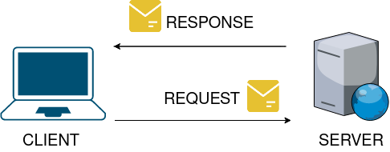
Back-end web development ∙ Introduction
Client-Server Architecture
Fabio Giachelle
Corso FSE Big Data 2021

Slide 3
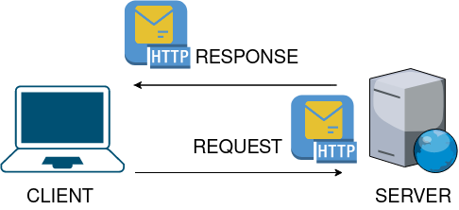
Back-end web development ∙ Introduction
Client-Server Architecture
Fabio Giachelle
Corso FSE Big Data 2021

Slide 4
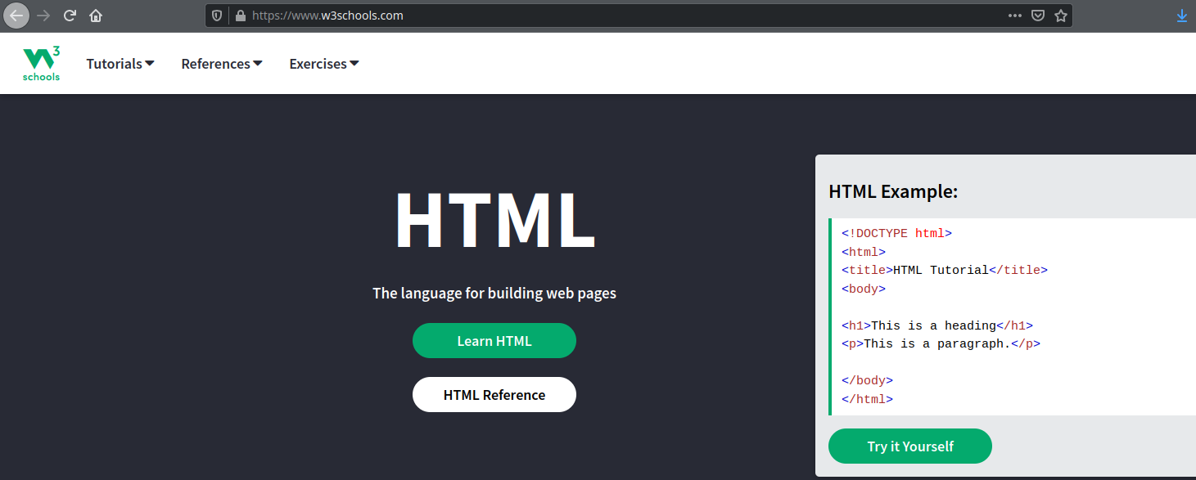
Back-end web development ∙ Introduction
What is HTTP?
https://www.w3schools.com
HyperText Transfer Protocol (HTTP): A stateless application protocol that regulates the exchange of messages between a Web client and a Web server.
Fabio Giachelle
Corso FSE Big Data 2021

Slide 5
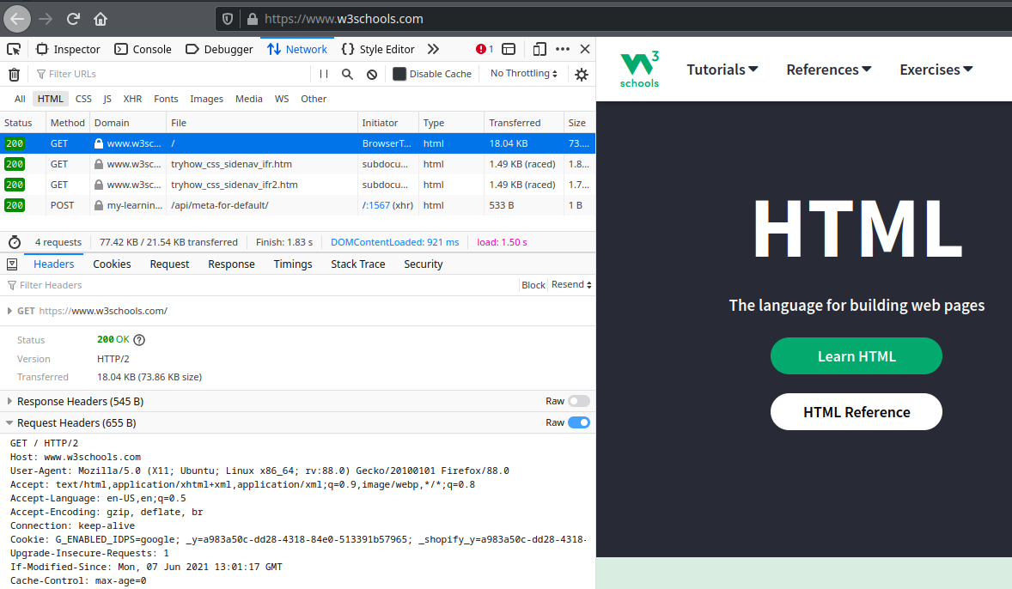
Back-end web development ∙ Introduction
What is HTTP?
HyperText Transfer Protocol (HTTP): A stateless application protocol that regulates the exchange of messages between a Web client and a Web server.
REQUEST HTTP
Request Headers:
Host: www.w3shools.com
Method: GET
HTTP version: 2
User-Agent: Mozilla/5.0
Fabio Giachelle
Corso FSE Big Data 2021

Slide 6
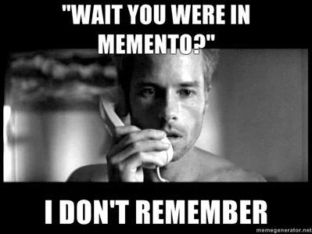

Back-end web development ∙ Introduction
HTTP properties
Stateless (memory-less): the HTTP protocol does not memorizes any information about the connections performed in the past.
TCP/IP based: the client relies on TCP/IP protocols in order to connect to the server.
Reference: HTTP 1.0 - RFC 1945 https://datatracker.ietf.org/doc/html/rfc1945
Fabio Giachelle
Corso FSE Big Data 2021

Slide 7
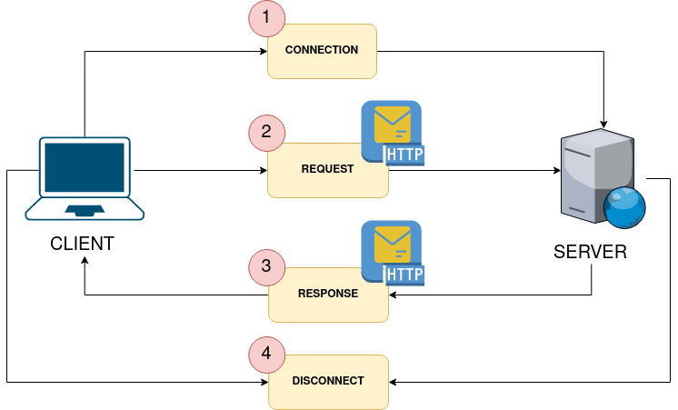
Back-end web development ∙ Introduction
HTTP phases
Fabio Giachelle
Corso FSE Big Data 2021

Slide 8
Back-end web development ∙ Introduction
HTTP methods
GET: allows to retrieve, for instance, the information content of a web page identified by its URL.
POST: allows to send data (payload) to a web page.
PUT: replaces all current representations of the target resource with the request payload.
DELETE: deletes the resource identified by the request URI.
HEAD: same as GET request, but without the response body.
OPTIONS: describe the communication options available for the target resource.
Most used HTTP methods for basic web applications
Reference: https://developer.mozilla.org/en-US/docs/Web/HTTP/Methods
Fabio Giachelle
Corso FSE Big Data 2021

Slide 9
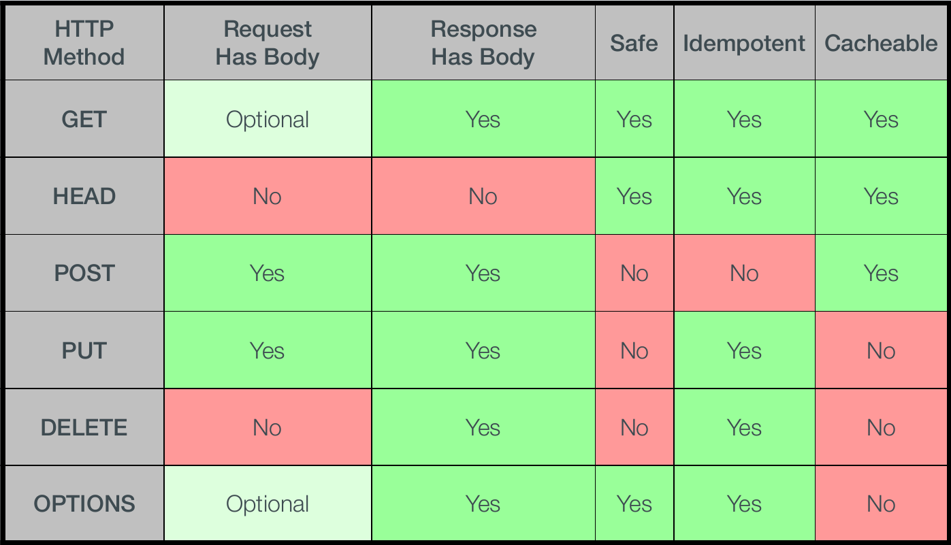
Back-end web development ∙ Introduction
HTTP methods summary
Fabio Giachelle
Corso FSE Big Data 2021

Slide 10




Back-end web development ∙ Introduction
How to make HTTP requests?
Use Web clients!
Web browser
curl Web client
POSTMAN Web client
Fabio Giachelle
Corso FSE Big Data 2021

Slide 11
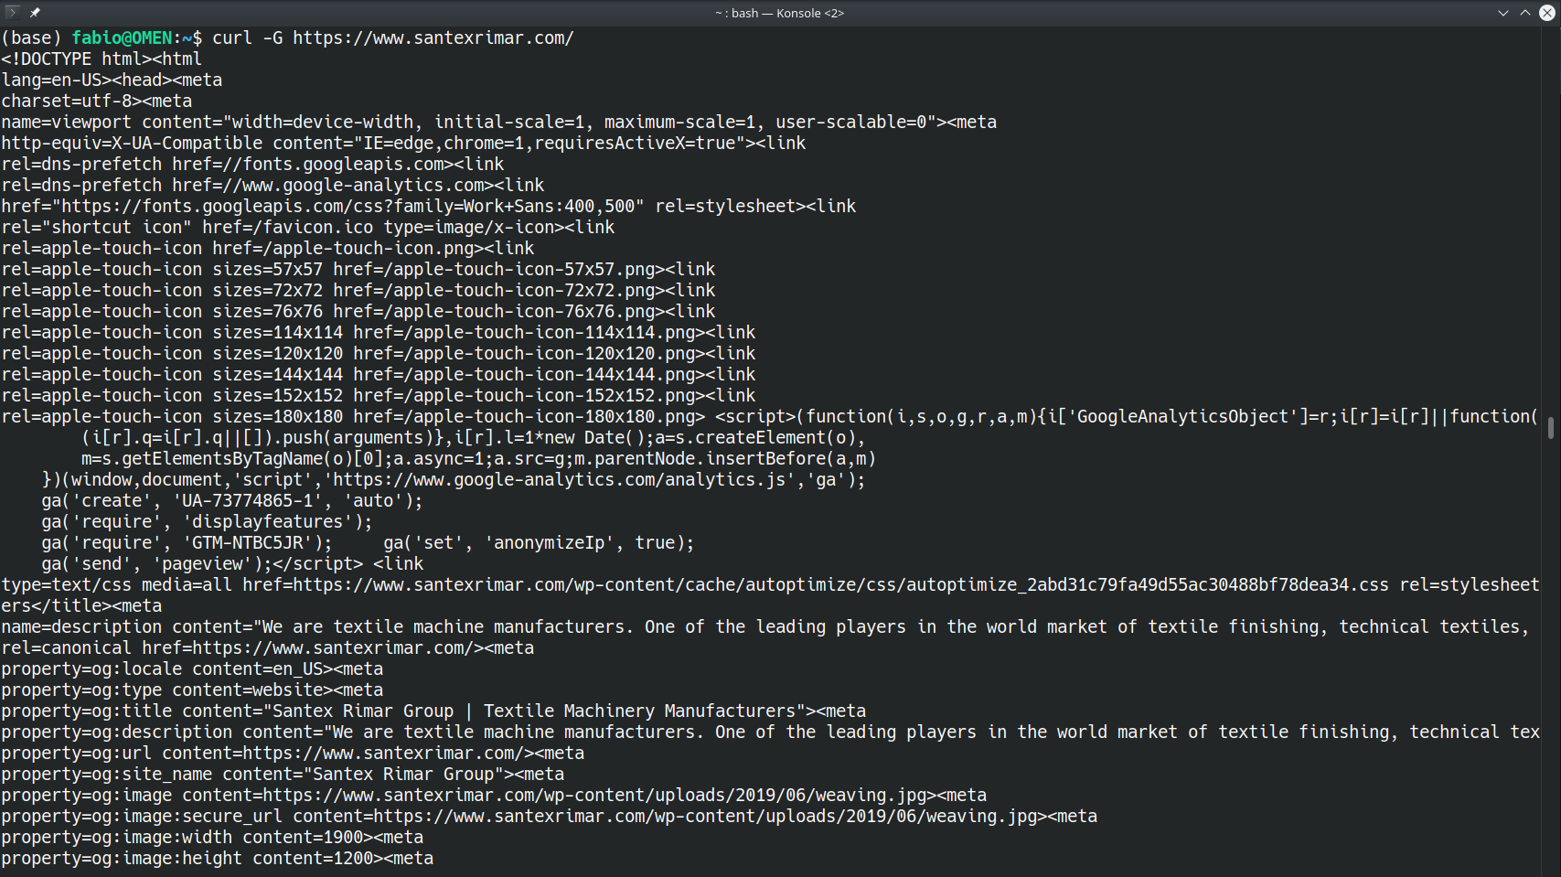
Back-end web development ∙ Introduction
How to make HTTP requests?
Reference:
https://curl.se/docs/manpage.html
Fabio Giachelle
Corso FSE Big Data 2021

Slide 12
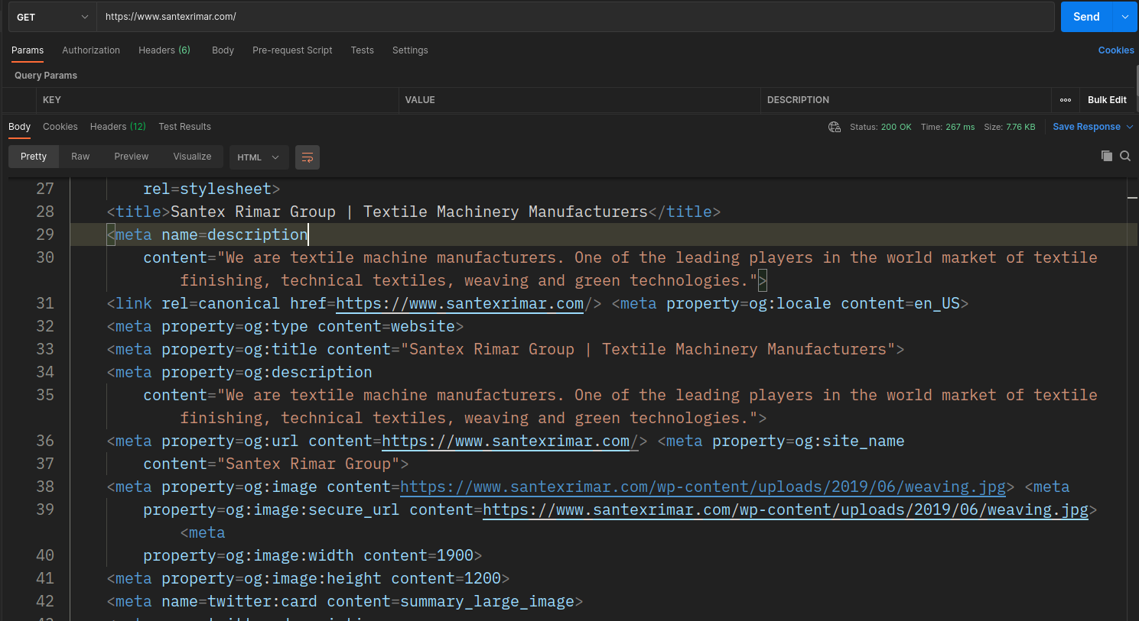
Back-end web development ∙ Introduction
How to make HTTP requests?
Reference:
https://www.postman.com/
Fabio Giachelle
Corso FSE Big Data 2021

Slide 13
Back-end web development
HTML introduction
Examples and source code available on
https://github.com/giachell/Big_data_course_FSE_2021
Fabio Giachelle
Corso FSE Big Data 2021

Slide 14

Back-end web development ∙ HTML Introduction
What is HTML?
HTML stands for HyperText Markup Language. The HyperText part refers to the fact that HTML allows you to create links that allow visitors to move from one page to another quickly and easily.
A markup language allows you to annotate text, and these annotations provide additional meaning to the contents of a document.
HTML allows to structure web pages so that their information content is arranged according to the layout specified by HTML tags.
How to view the HTML source code of a web page using a browser:
Right-click in an HTML page and click the “View Page Source” option (in Chrome) or “View Source” in Edge. A similar option is present also in other browsers. There is also a keyboard shortcut CTRL + U (valid for Chrome/Firefox on Windows and Linux).
Reference: https://www.w3schools.com/html/
Fabio Giachelle
Corso FSE Big Data 2021

Slide 15
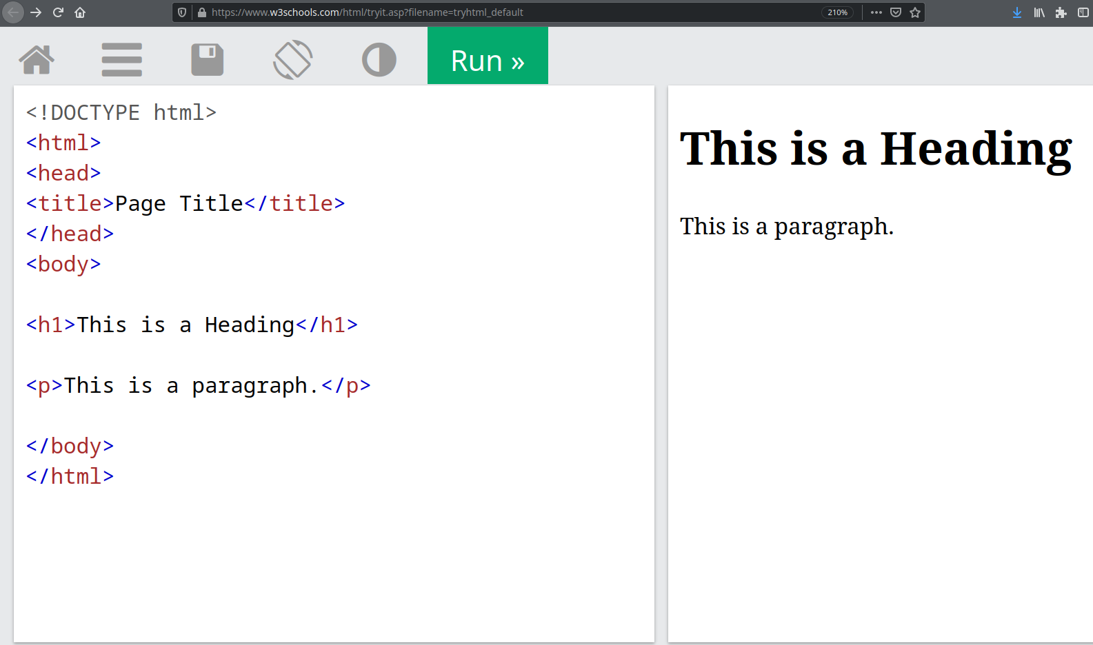
Back-end web development ∙ HTML Introduction
A simple HTML page
W3schools try-it website: https://www.w3schools.com/html/tryit.asp?filename=tryhtml_default
Fabio Giachelle
Corso FSE Big Data 2021

Slide 16
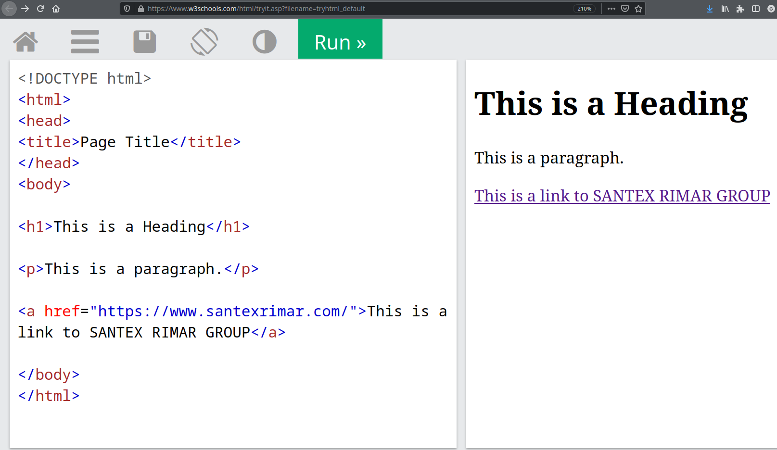
Back-end web development ∙ HTML Introduction
A simple HTML page
W3schools try-it website: https://www.w3schools.com/html/tryit.asp?filename=tryhtml_default
Fabio Giachelle
Corso FSE Big Data 2021

Slide 17
Back-end web development ∙ HTML Introduction
The anatomy of an HTML tag
The paragraph tag
<p> This is a paragraph </p>
Opening tag
The actual text of the paragraph
Closing tag
p is the Tag name and stands for paragraph
Fabio Giachelle
Corso FSE Big Data 2021

Slide 18
Back-end web development ∙ HTML Introduction
The anatomy of an HTML tag
The heading tag
<h1> This is a Heading </h1>
Opening tag
The actual text of the heading
Closing tag
h1 is the Tag name and stands for first-level heading
Fabio Giachelle
Corso FSE Big Data 2021

Slide 19
Back-end web development ∙ HTML Introduction
The anatomy of an HTML tag
The hyperlink tag
a is the Tag name and defines a hyperlink
<a href="https://www.santexrimar.com/">This is a link to SANTEX RIMAR GROUP</a>
href is a tag attribute, which indicates the link's destination
The actual text of the link.
NB: This is the only part visible to the user.
Fabio Giachelle
Corso FSE Big Data 2021

Slide 20
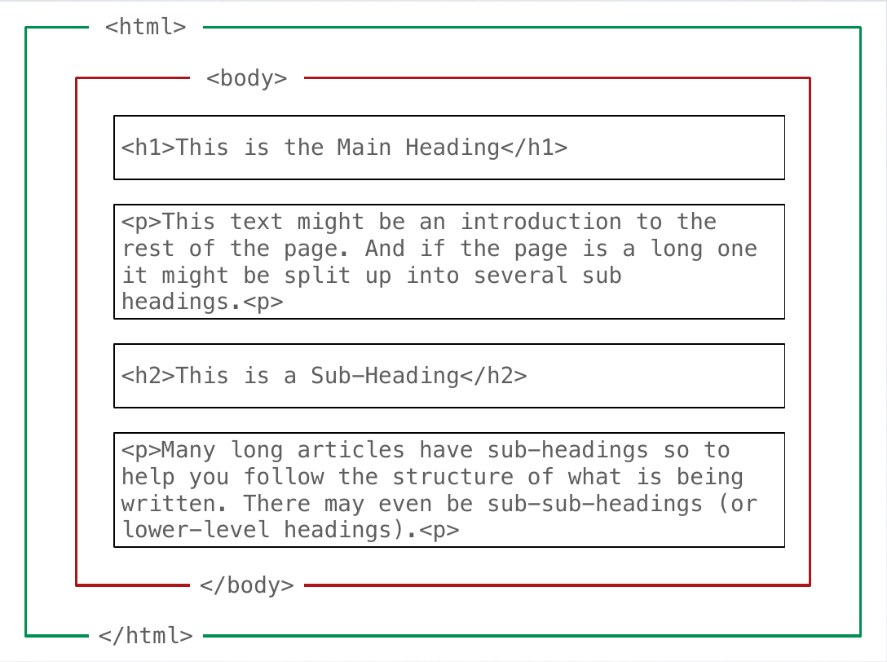
Back-end web development ∙ HTML Introduction
The anatomy of an HTML web page
The html tag is the root element and contains all the elements that make up a web page.
The body tag contains all the elements that are visible in a web page.
Fabio Giachelle
Corso FSE Big Data 2021

Slide 21
Back-end web development ∙ HTML Introduction
Other relevant HTML tags
HTML Headings: defined with the <h1> to <h6> tags. <h1> defines the most important heading (biggest); <h6> defines the least important heading (smallest).
HTML Images: defined with the <img> tag.
Properties:
The src attribute allows to specify the image source file.
The alt attribute allows to specify the alternative text shown in case the image cannot be displayed.
The width and height attributes specify the width and the height respectively of the image.
HTML line break: The <br> tag inserts a single line break. After the line break the text is wrapped.
Reference: https://www.w3schools.com/html/html_basic.asp
Fabio Giachelle
Corso FSE Big Data 2021

Slide 22
Back-end web development ∙ HTML Introduction
Other relevant HTML tags
HTML Lists: there are two main types of HTML lists:
Ordered lists: defined with tag <ol>
Unordered lists: defined with tag <ul>
Each list item starts with the <li> tag
HTML tables: defined using the <table> tag.
Properties:
Each table row is defined with a <tr> tag. Each table header is defined with a <th> tag. Each table cell is defined with a <td> tag.
By default, the text in <th> elements are bold and centered.
By default, the text in <td> elements are regular and left-aligned.
Reference: https://www.w3schools.com/html/html_basic.asp
Fabio Giachelle
Corso FSE Big Data 2021

Slide 23
Back-end web development ∙ HTML Introduction
HTML forms
HTML forms allow the users to provide information by filling up input fields (e.g. text boxes, check boxes and drop-down lists).
The HTML <form> define an HTML form and act as a container for different types of input elements, such as: text fields, checkboxes, radio buttons, submit buttons, etc.
Properties:
The action attribute allows to specify the URL of the destination web page that will receive the form data. (Where the form data are sent)
The method attribute allows to specify the HTTP method (e.g. GET, POST) used to send the form data. (How the form data are sent)
Reference:
https://www.w3schools.com/html/html_forms.asp
https://www.w3schools.com/html/tryit.asp?filename=tryhtml_form_submit
Fabio Giachelle
Corso FSE Big Data 2021

Slide 24
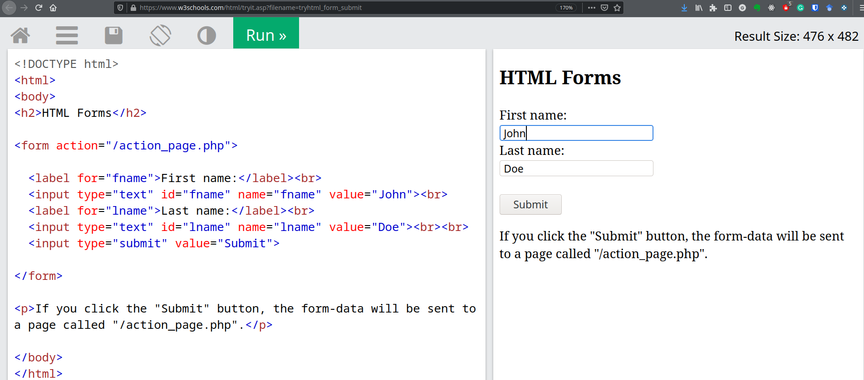
Back-end web development ∙ HTML Introduction
Reference:
https://www.w3schools.com/html/html_forms.asp
https://www.w3schools.com/html/tryit.asp?filename=tryhtml_form_submit
HTML form example
Fabio Giachelle
Corso FSE Big Data 2021

Slide 25
Back-end web development ∙ HTML Introduction
Reference:
https://www.w3schools.com/html/html_forms.asp
https://www.w3schools.com/html/tryit.asp?filename=tryhtml_form_submit
HTML form example
Web page that receives and handles the form data…It’s a PHP web page!
Fabio Giachelle
Corso FSE Big Data 2021

Slide 26
Back-end web development
PHP introduction
Examples and source code available on
https://github.com/giachell/Big_data_course_FSE_2021
Fabio Giachelle
Corso FSE Big Data 2021

Slide 27
Back-end web development ∙ PHP Introduction
Why PHP?
HTML web pages are static their content never changes! (unless the web developer change it manually)
Most of the websites need to show dynamic web pages whose content changes automatically based on the user input (e.g. social networks, e-commerce marketplace and so on…)
PHP allows to generate HTML web pages dynamically, that is, the content of web pages is determined on-demand according to the flow of a PHP script, executed on a web server.
Reference: https://www.w3schools.com/php/
Fabio Giachelle
Corso FSE Big Data 2021

Slide 28
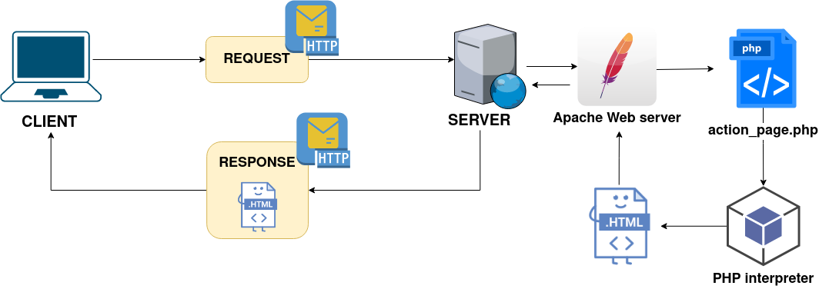
Back-end web development ∙ PHP Introduction
Why PHP?
PHP: Hypertext Preprocessor is a scripting language designed for web development.
PHP allows to generate HTML web pages dynamically, that is, the content of web pages is determined on-demand according to the flow of a PHP script, executed on a web server.
Reference: https://www.w3schools.com/php/
Fabio Giachelle
Corso FSE Big Data 2021

Slide 29
Back-end web development ∙ PHP Introduction
What is a web server?
A web server is a software that continuously perform the following cycle:
Accepts requests via HTTP
Finds the requested web page (e.g. action_page.php)
Invokes the proper interpreter for the web page (e.g. PHP interpreter)
Returns the HTML representation of the web page
Fabio Giachelle
Corso FSE Big Data 2021

Slide 30
Back-end web development ∙ PHP Introduction
Installation of Apache web server
In order to easily install Apache web server, we install the Bitnami WAPP Stack platform, which provides a complete and ready to run development environment.
Bitnami WAPP Stack includes the PHP interpreter, the PostgreSQL database management system and the Apache web server.
Download Bitnami WAPP Stack for:
Windows
MacOS
Linux
Fabio Giachelle
Corso FSE Big Data 2021

Slide 31
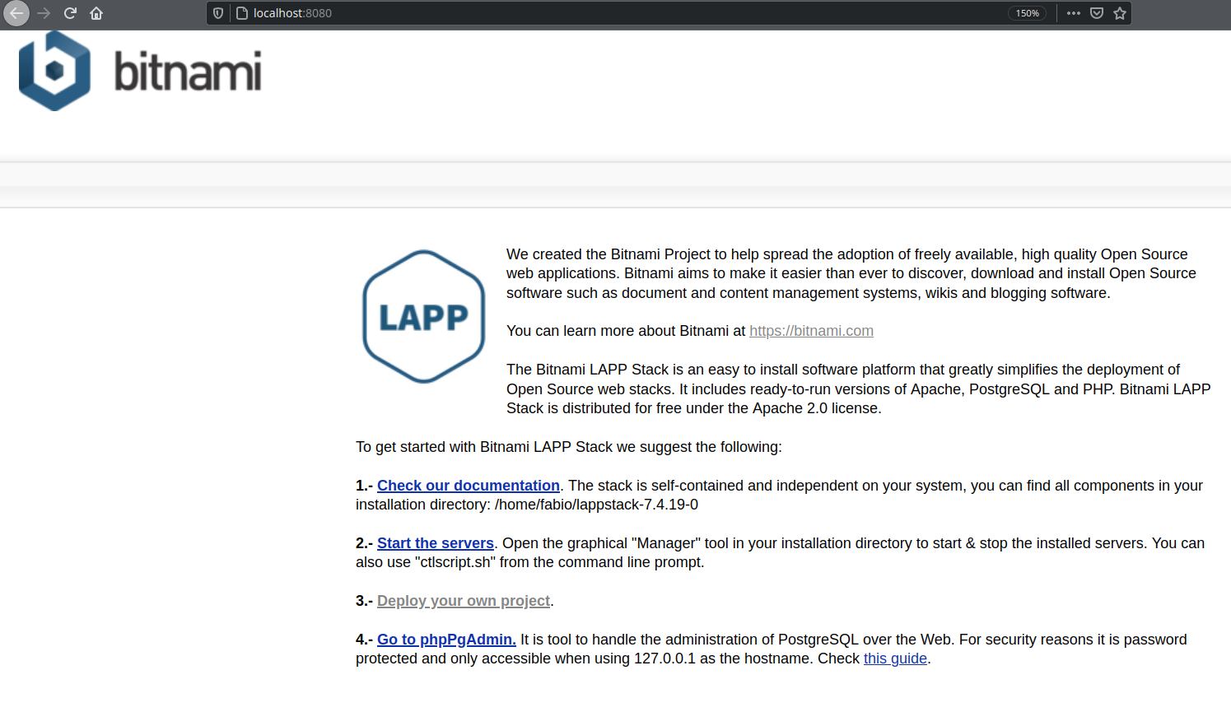
Back-end web development ∙ PHP Introduction
Installation of Apache web server
Once the installation process complete, you can reach the default page provided by the web server.
To this aim, open your browser and go to http://localhost
Fabio Giachelle
Corso FSE Big Data 2021

Slide 32
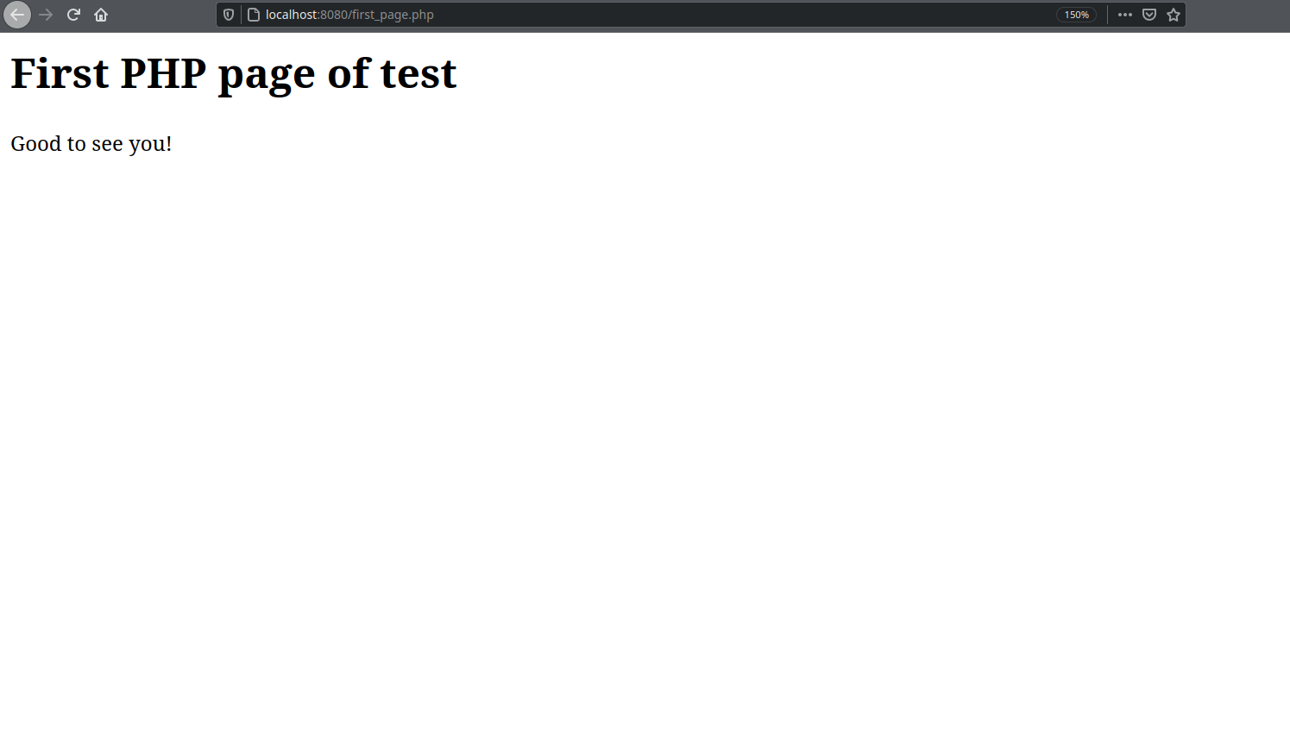
Back-end web development ∙ PHP Introduction
PHP example #1
To see your PHP page in the browser, put it inside the following folder:
On Windows:
C:\Bitnami\wappstack-<VERSION_NUMBER>\apache2\htdocs
The source code of the first PHP page is available on Github
To access the first PHP page in your browser, go to: http://localhost/first_page.php
Fabio Giachelle
Corso FSE Big Data 2021

Slide 33
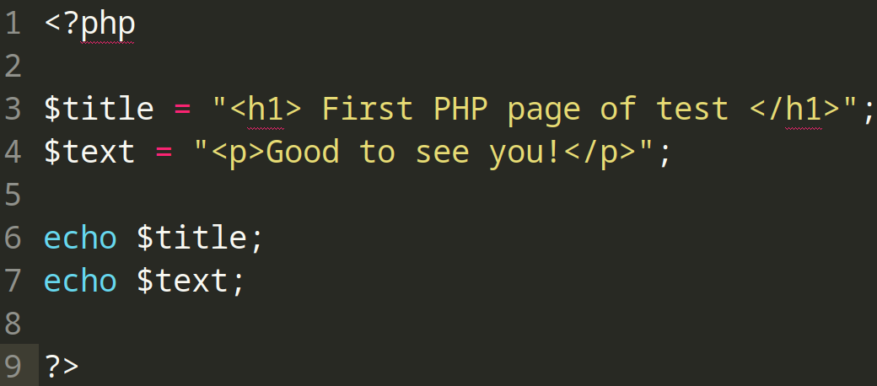
Back-end web development ∙ PHP Introduction
PHP example #1
PHP source code
Fabio Giachelle
Corso FSE Big Data 2021

Slide 34
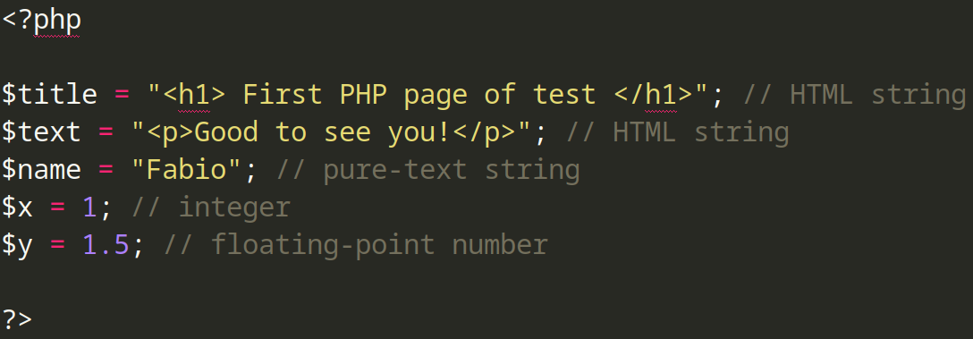
Back-end web development ∙ PHP Introduction
PHP variables
Variables allow to store values (e.g. numbers, html text and PHP objects) used for the generation of web pages.
Variables in PHP start with a dollar sign ($)
Variables must be declared inside opening PHP tag <?php and closing PHP tag ?>
Every variable declaration must end with a semicolon ;
Examples of variables:
Fabio Giachelle
Corso FSE Big Data 2021

Slide 35
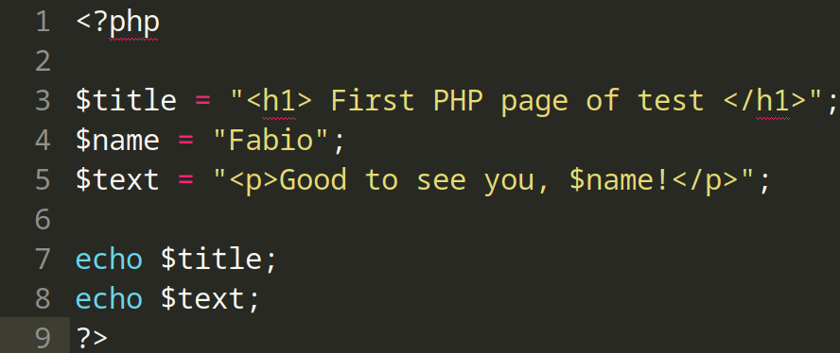
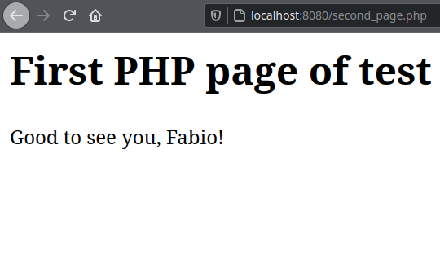
Back-end web development ∙ PHP Introduction
PHP example #2
PHP source code
HTML result in Firefox
The variable $name contains the value «Fabio»,
which is embedded into the $text variable.
Fabio Giachelle
Corso FSE Big Data 2021

Slide 36
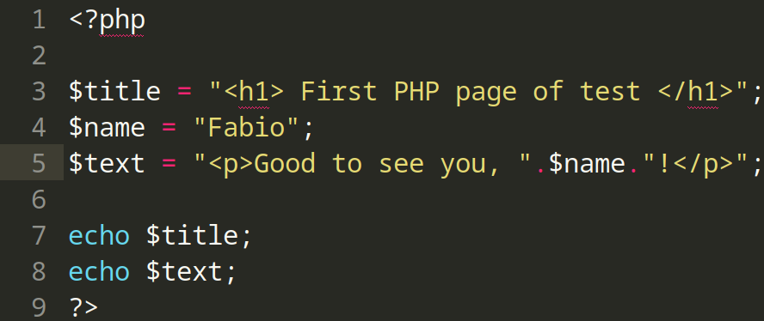
Back-end web development ∙ PHP Introduction
PHP example #2 (variation)
PHP source code
HTML result in Firefox
The variable $name contains the value «Fabio»,
which is chained into the $text variable.
Fabio Giachelle
Corso FSE Big Data 2021

Slide 37
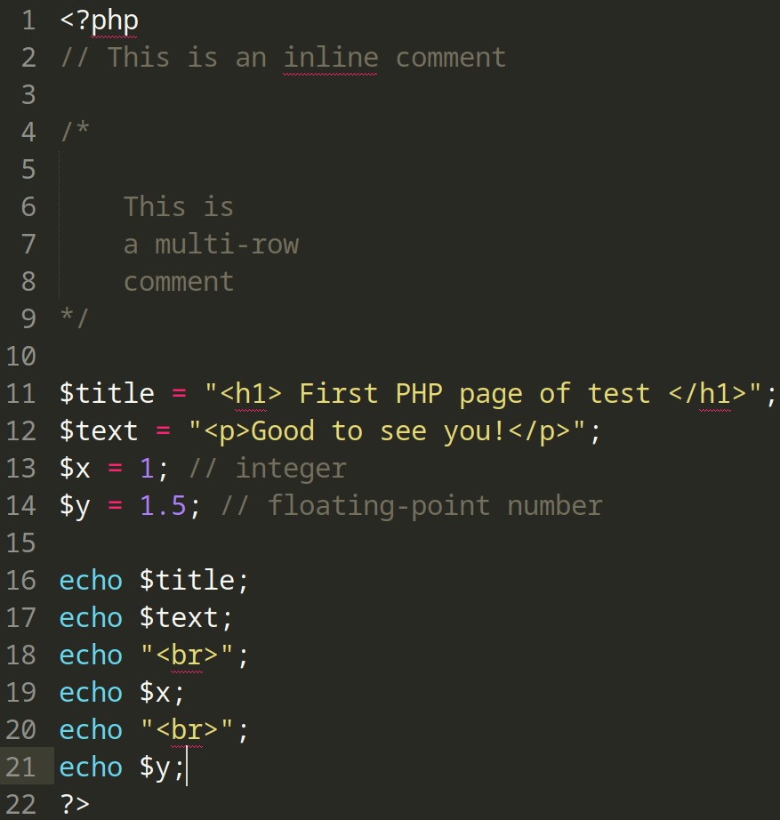
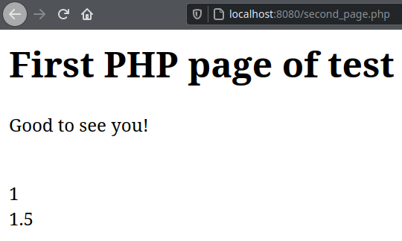
Back-end web development ∙ PHP Introduction
PHP example #3
Fabio Giachelle
Corso FSE Big Data 2021

Slide 38
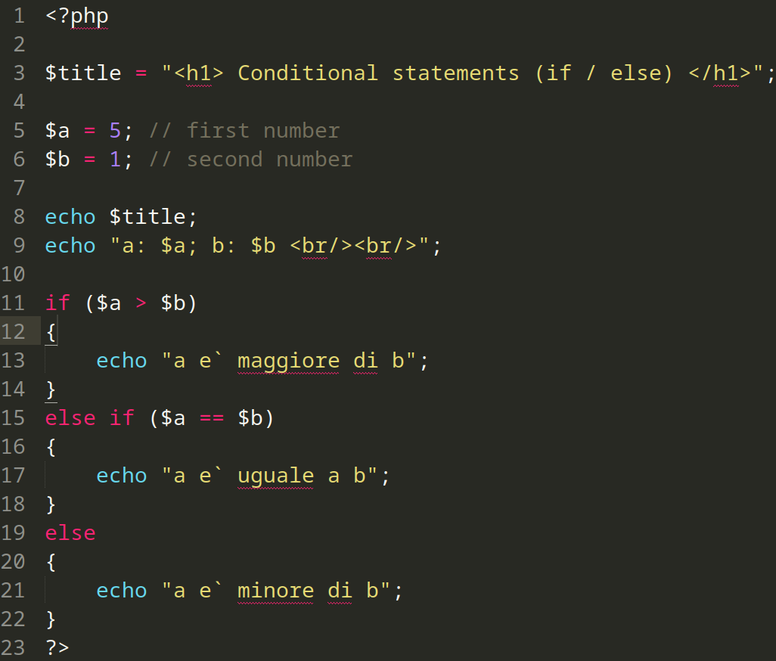
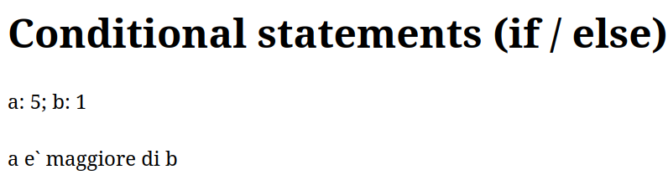
Back-end web development ∙ PHP Introduction
PHP example #4 (Conditional statements)
Fabio Giachelle
Corso FSE Big Data 2021

Slide 39
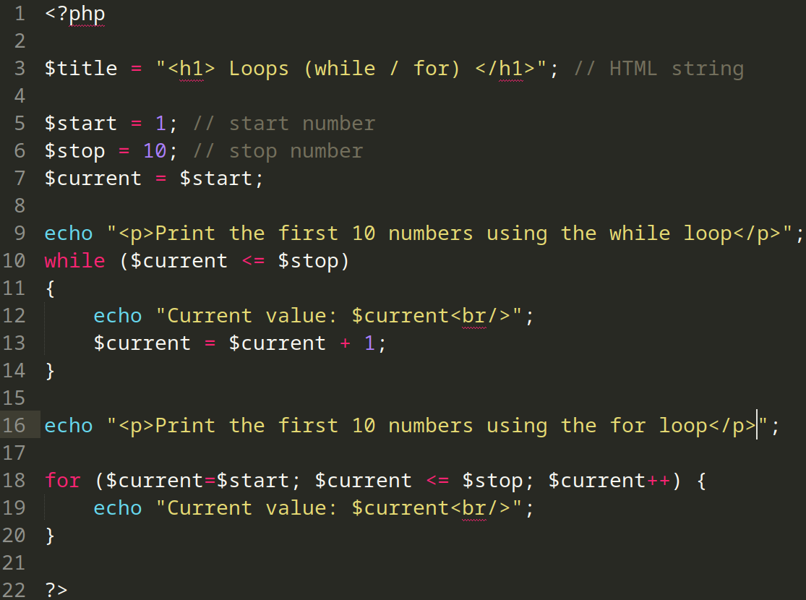
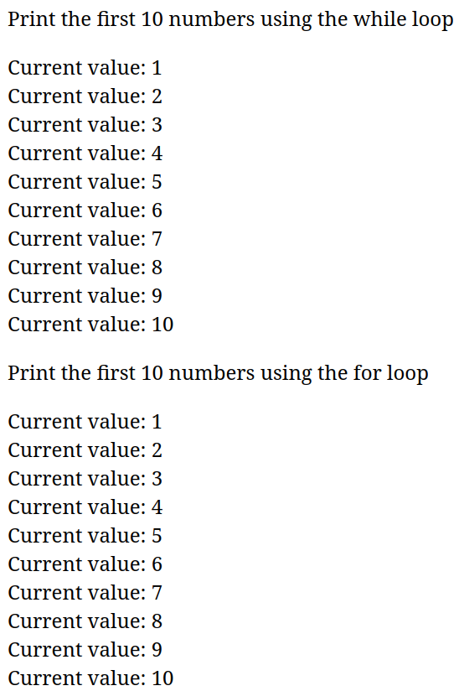
Back-end web development ∙ PHP Introduction
PHP example #5 (Loops)
Fabio Giachelle
Corso FSE Big Data 2021

Slide 40
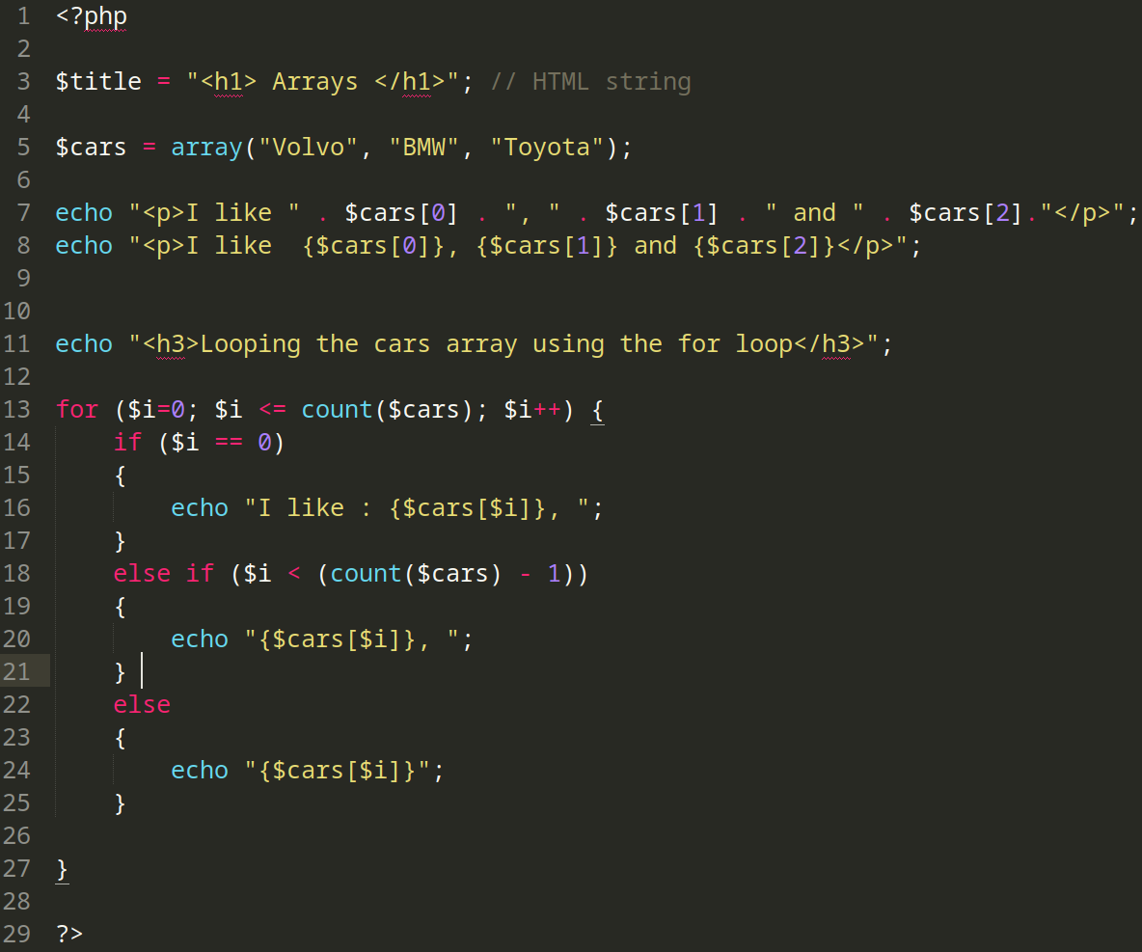
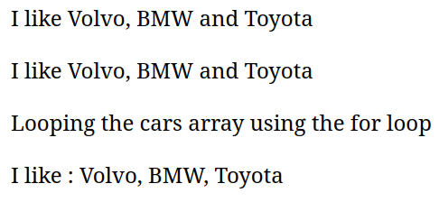
Back-end web development ∙ PHP Introduction
PHP example #6 (Arrays)
Fabio Giachelle
Corso FSE Big Data 2021

Slide 41

Back-end web development ∙ PHP Introduction
Thank you for your kind attention
Fabio Giachelle
Corso FSE Big Data 2021

